Slide 1
Increasing Revenue and Price Per Square Foot of Future Sales

Slide 2
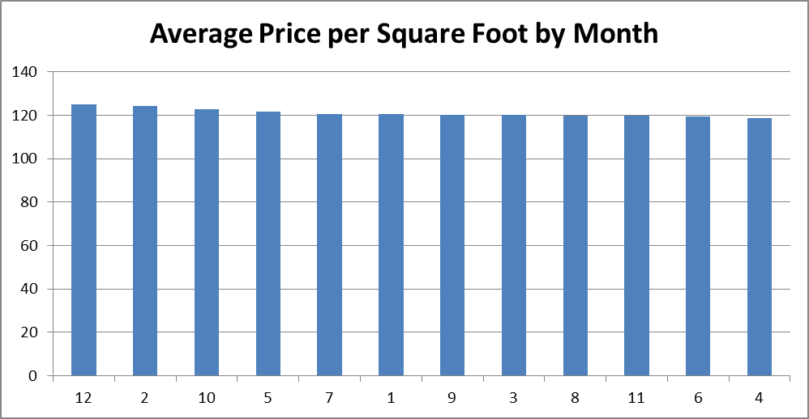
Month to Month PPSF Comparison

Slide 3
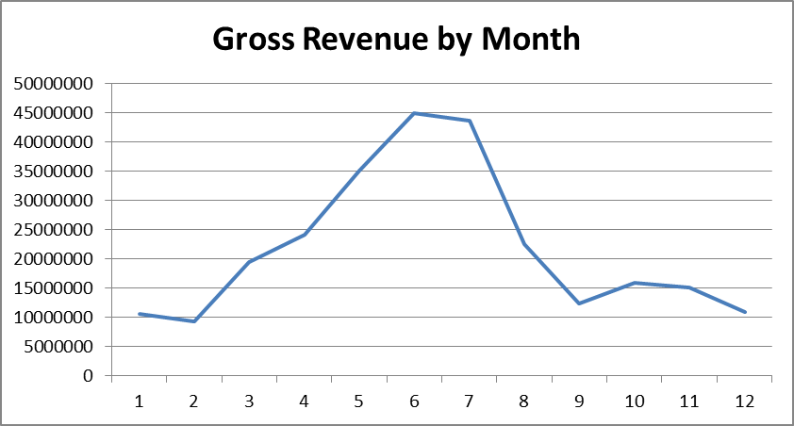
Month to Month Gross Revenue Comparison

Slide 4
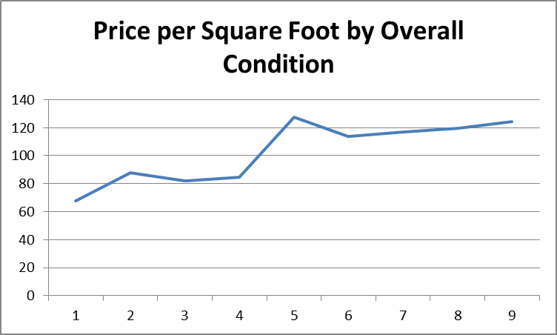
Home Condition by PPSF

Slide 5
Specific Insights
Is there a statistically significant differential in average price per square foot based on lot shape?
Is there a statistically significant differential in average price per square foot for 1 story and 2 story homes?
Is there a statistically significant differential in average price per square foot for remodeled and non-remodeled homes?
Is there a statistically significant differential in average price per square foot for corner and inside lots?

Slide 6
Lot Shape Analysis
Ho: The mean price per square foot for Irregular Lot Sizes = mean of price per square foot for regular lot sizes.
Ha: The mean price per square foot for irregular lot sizes <> mean price per square foot for regular lot sizes
The null hypotheses is rejected as the P value is 5.89615331377524E-13, which is substantially less that our alpha of .05.
We are 95% confident that the mean difference between our two samples is 8.825133087 and 15.32939366

Slide 7
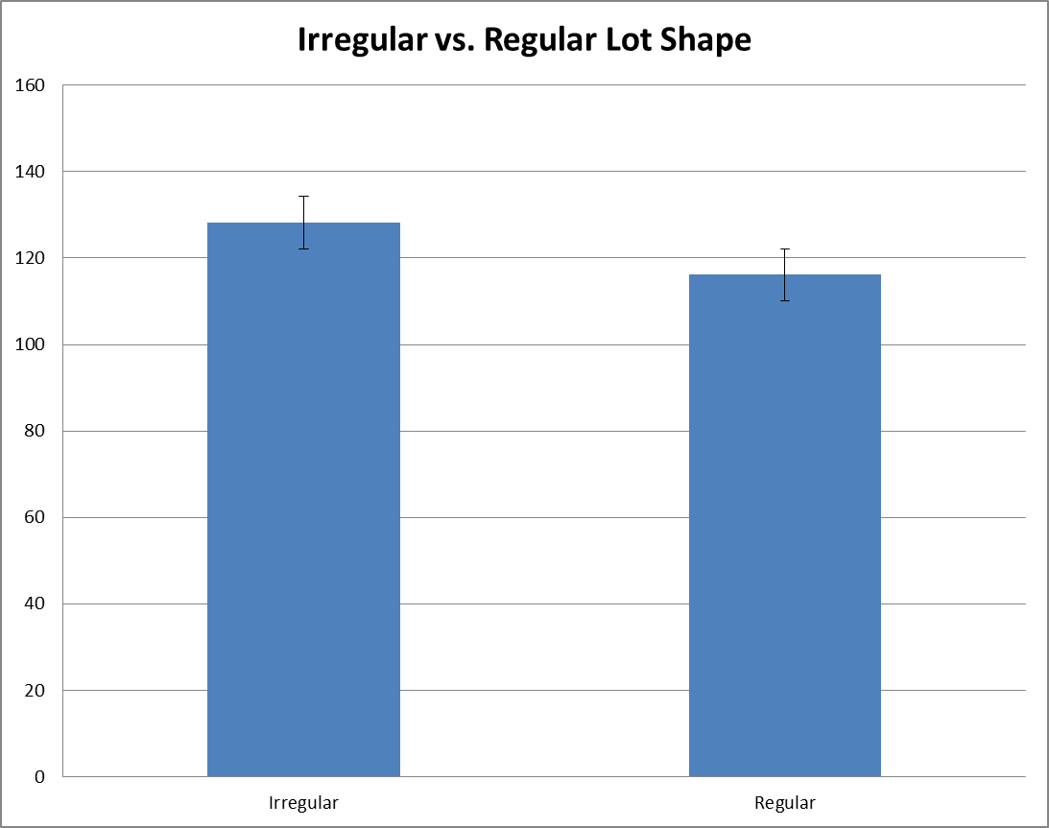
Lot Shape Analysis

Slide 8
1 Story vs. 2 Story
Ho: The mean price per square foot for 1 Story homes = mean of price per square foot for 2 story homes.
Ha: The mean price per square foot for 1 story homes <> mean price per square foot for 2 story homes.
The null hypotheses is rejected as the P value is 1.64237082879103E-39, which is substantially less that our alpha of .05.
We are 95% confident that the mean difference between our two samples is 25.77429521 and 19.31265138

Slide 9
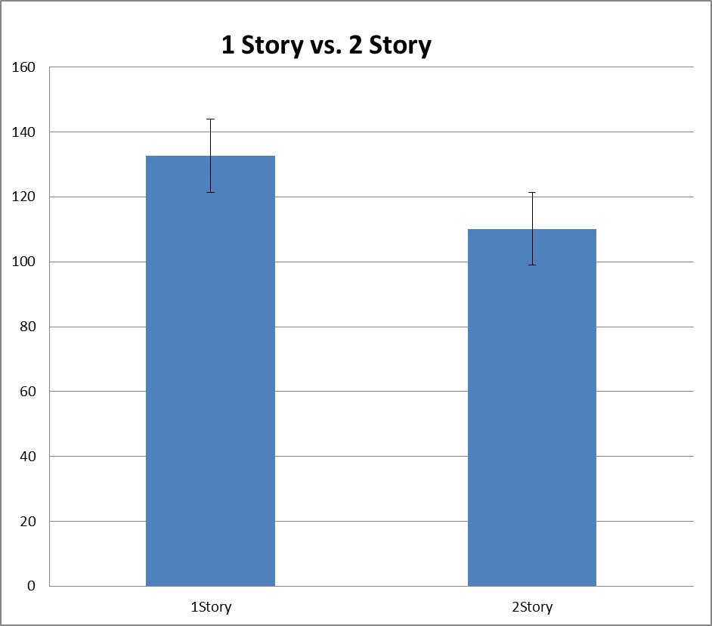
1 Story vs. 2 Story

Slide 10
Corner vs. Inside Lot
Ho: The mean price per square foot for Corner Lots = mean of price per square foot for Inside lots.
Ha: The mean price per square foot for Corner Lots <> mean price per square foot for Inside Lots.
The null hypothesis cannot be rejected as the P value is .225767, which is not less than our alpha of .05.
We are 95% confident that the mean difference between our two samples is 1.605565 and -6.78172

Slide 11
Corner vs. Inside Lot

Slide 12
Remodel vs. Non-Remodel
Ho: The mean price per square foot for non-remodeled homes = mean of price per square foot for remodeled homes.
Ha: The mean price per square foot for non-remodeled homes <> mean price per square foot for remodeled homes.
The null hypothesis cannot be rejected as the P value is .171602737, which is not less than our alpha of .05.
We are 95% confident that the mean difference between our two samples is 5.49410169 and -.97999788

Slide 13
Remodel vs. Non-Remodel

Slide 14
Key Takeaways
December has the highest price per square foot on a month to month comparison, however it is one of the lowest months for total gross revenue.
June and July are the highest grossing months for total revenue, however June has the second lowest price per square foot.
July ranks fifth in price per square foot.
Condition 5 ranks highest in price per square foot.

Slide 15
Key Takeaways
There is a statistically significant differential in price per square foot based on lot shape.
There is a statistically significant differential in price per square foot based on number of stories.
There is not a statistically significant differential in price per square foot based on remodel condition.
There is not a statistically significant differential in price per square foot based on lot type.

Slide 16
Recommendations
Focus on increasing minimizing sales in the month of June and maximizing sales in the month of July and the month of December to maximize gross revenue and price per square foot.
Focus on homes in condition 5 or condition 9 to maximize price per square foot.
Focus on irregular lot shapes and 1 story homes to maximize price per square foot.
Key assumption – demand will exist to make these changes to listing strategy.

Slide 17
Thank you!

